Slide 1
Summary Evaluation Platform
M.Sc. Final Project Report
Sergey Mordeev
Project Supervisor: Dr. Marina Litvak

Slide 2
Problem Statement - What
Gathering, processing and results’ interpretation are not simple in general
In a highly specialized field the “problem” becomes a “real headache”
Automatic Text Summarization Evaluation is no an exception…

Slide 3
Summarization Task
In a “minimum” words: distilling the most important information from source(s) for particular user(s) and/or task(s)
Why? Over-information.
What by?
Humans [“the best one”?] (in reality, expensive and subjective)
Machines [automated] (in reality, ☺)

Slide 4
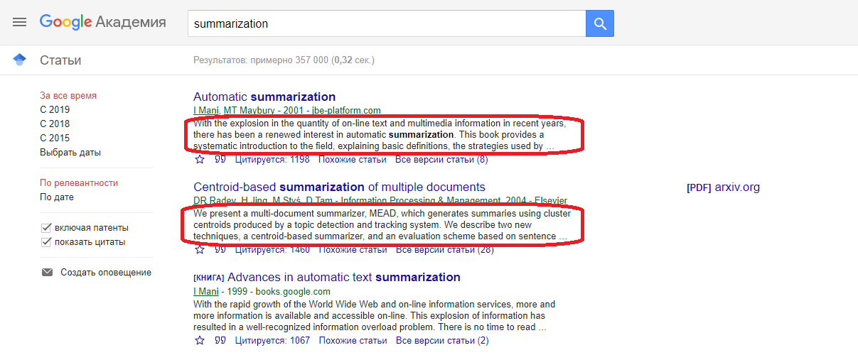
Summarization Task (in action) - Example

Slide 5
“Researcher” task
A “researcher” wants
Better than another “researcher” automatic summarizer
To prove or to have a direction for a prove that it is better
Not wasting a time on annoying intermediate steps
A “researcher” does not want
Manually perform repetitive tasks
Automate the process (it is not the main goal for her/him eventually)
Realize that s/he may advance faster
A “researcher” may also want
Integrate/Extend existing automation
[There is some partial support… latter on this]

Slide 6
The “Platform” Main Idea
Automate and help to a researcher to infer faster conclusions
More Concretely
Combine accepted evaluation metrics
Allow [some] analysis of metrics [visual/statistic]
Non-functional requirements:
Fast [faster than existing solutions]
Extensible [conceptually, further development should be possible]
Reusable [highly modular]
Self-contained [as less as possible dependencies]

Slide 7
Summary Evaluation (bird’s-eye view)
Metric Category | Concrete Implemented Metrics
Informativeness | Rouge Metrics Family AutoSummENG Metrics
Surface | Various Readability Metrics

Slide 8
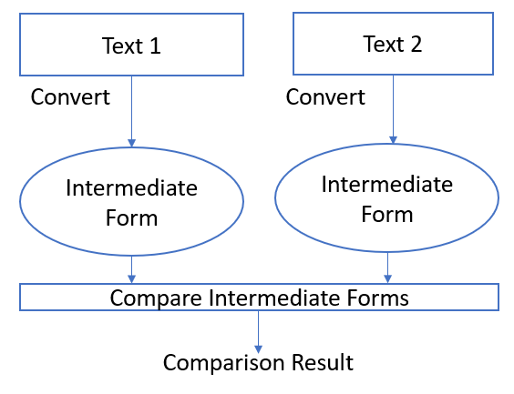
Text Comparisons

Slide 9
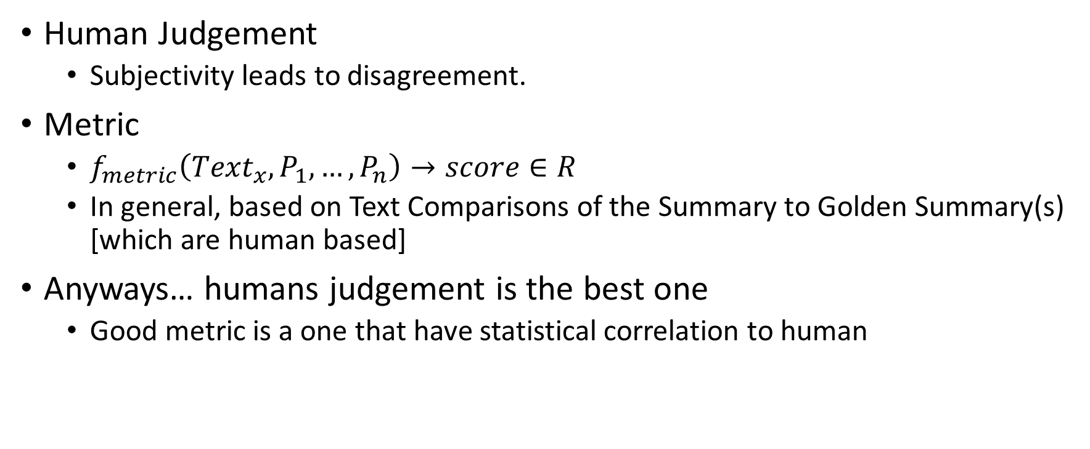
Summary Evaluation (“Informativeness”)
Human Judgement
Subjectivity leads to disagreement.
Metric
$f_{metric}\left({Text}_{x}, P_{1},…, P_{n}\right)→score∈R$
In general, based on Text Comparisons of the Summary to Golden Summary(s) [which are human based]
Anyways… humans judgement is the best one
Good metric is a one that have statistical correlation to human

Slide 10
Summary Evaluation (“Surface”)
Readability Metrics are based on the on the mapping from the text itself to a real number
By themselves, do not tell a much about summary. However, within comparison to the original texts can show the summarizer behavior aspects.

Slide 11
Informativeness Implemented Metrics
Rouge Family (Perl “ported” code)
Rouge N
Rouge S(U)
Rouge L
AutoSummENG (Reuse of the original package)
Words
Characters

Slide 12
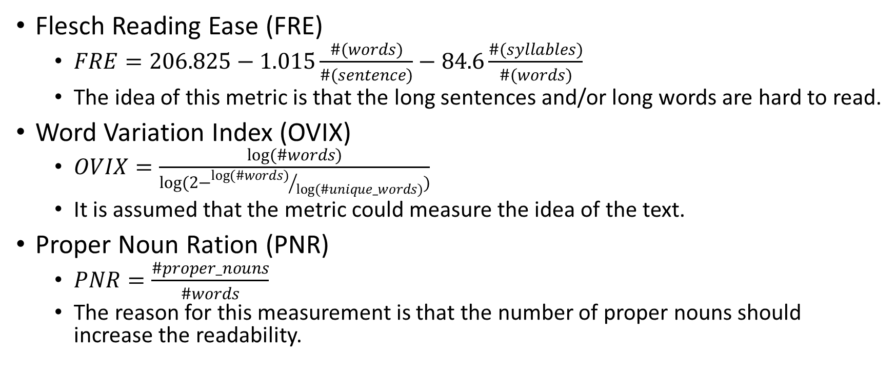
Surface (Readability) Implemented Metrics
Flesch Reading Ease (FRE)
$FRE=206.825−1.015\frac{\#(words)}{\#(sentence)}−84.6\frac{\#(syllables)}{\#(words)}$
The idea of this metric is that the long sentences and/or long words are hard to read.
Word Variation Index (OVIX)
$OVIX=\frac{log(\#words)}{log(2−{log(\#words)}/{log(\#unique_words)})}$
It is assumed that the metric could measure the idea of the text.
Proper Noun Ration (PNR)
$PNR=\frac{\#proper_nouns}{\#words}$
The reason for this measurement is that the number of proper nouns should increase the readability.

Slide 13
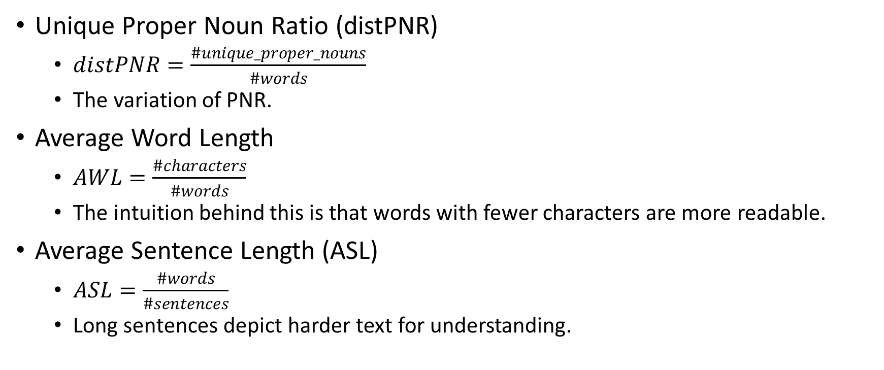
Surface (Readability) Implemented Metrics
Unique Proper Noun Ratio (distPNR)
$distPNR=\frac{\#unique_proper_nouns}{\#words}$
The variation of PNR.
Average Word Length
$AWL=\frac{\#characters}{\#words}$
The intuition behind this is that words with fewer characters are more readable.
Average Sentence Length (ASL)
$ASL=\frac{\#words}{\#sentences}$
Long sentences depict harder text for understanding.

